Slide 2
Thank you!
Feedback at the end
is appreciated. We’ll have plenty of time for questions, so hold onto them until the end if you can!

Slide 3
My Name is Angela Ward
Digital Product Manager & Digital Strategist at KBB Digital
20+ years in Marketing &
Ensuring Brand Consistency
Experience across many Industries, Cinema, Radio, Luxury Cars & Digital

Slide 4
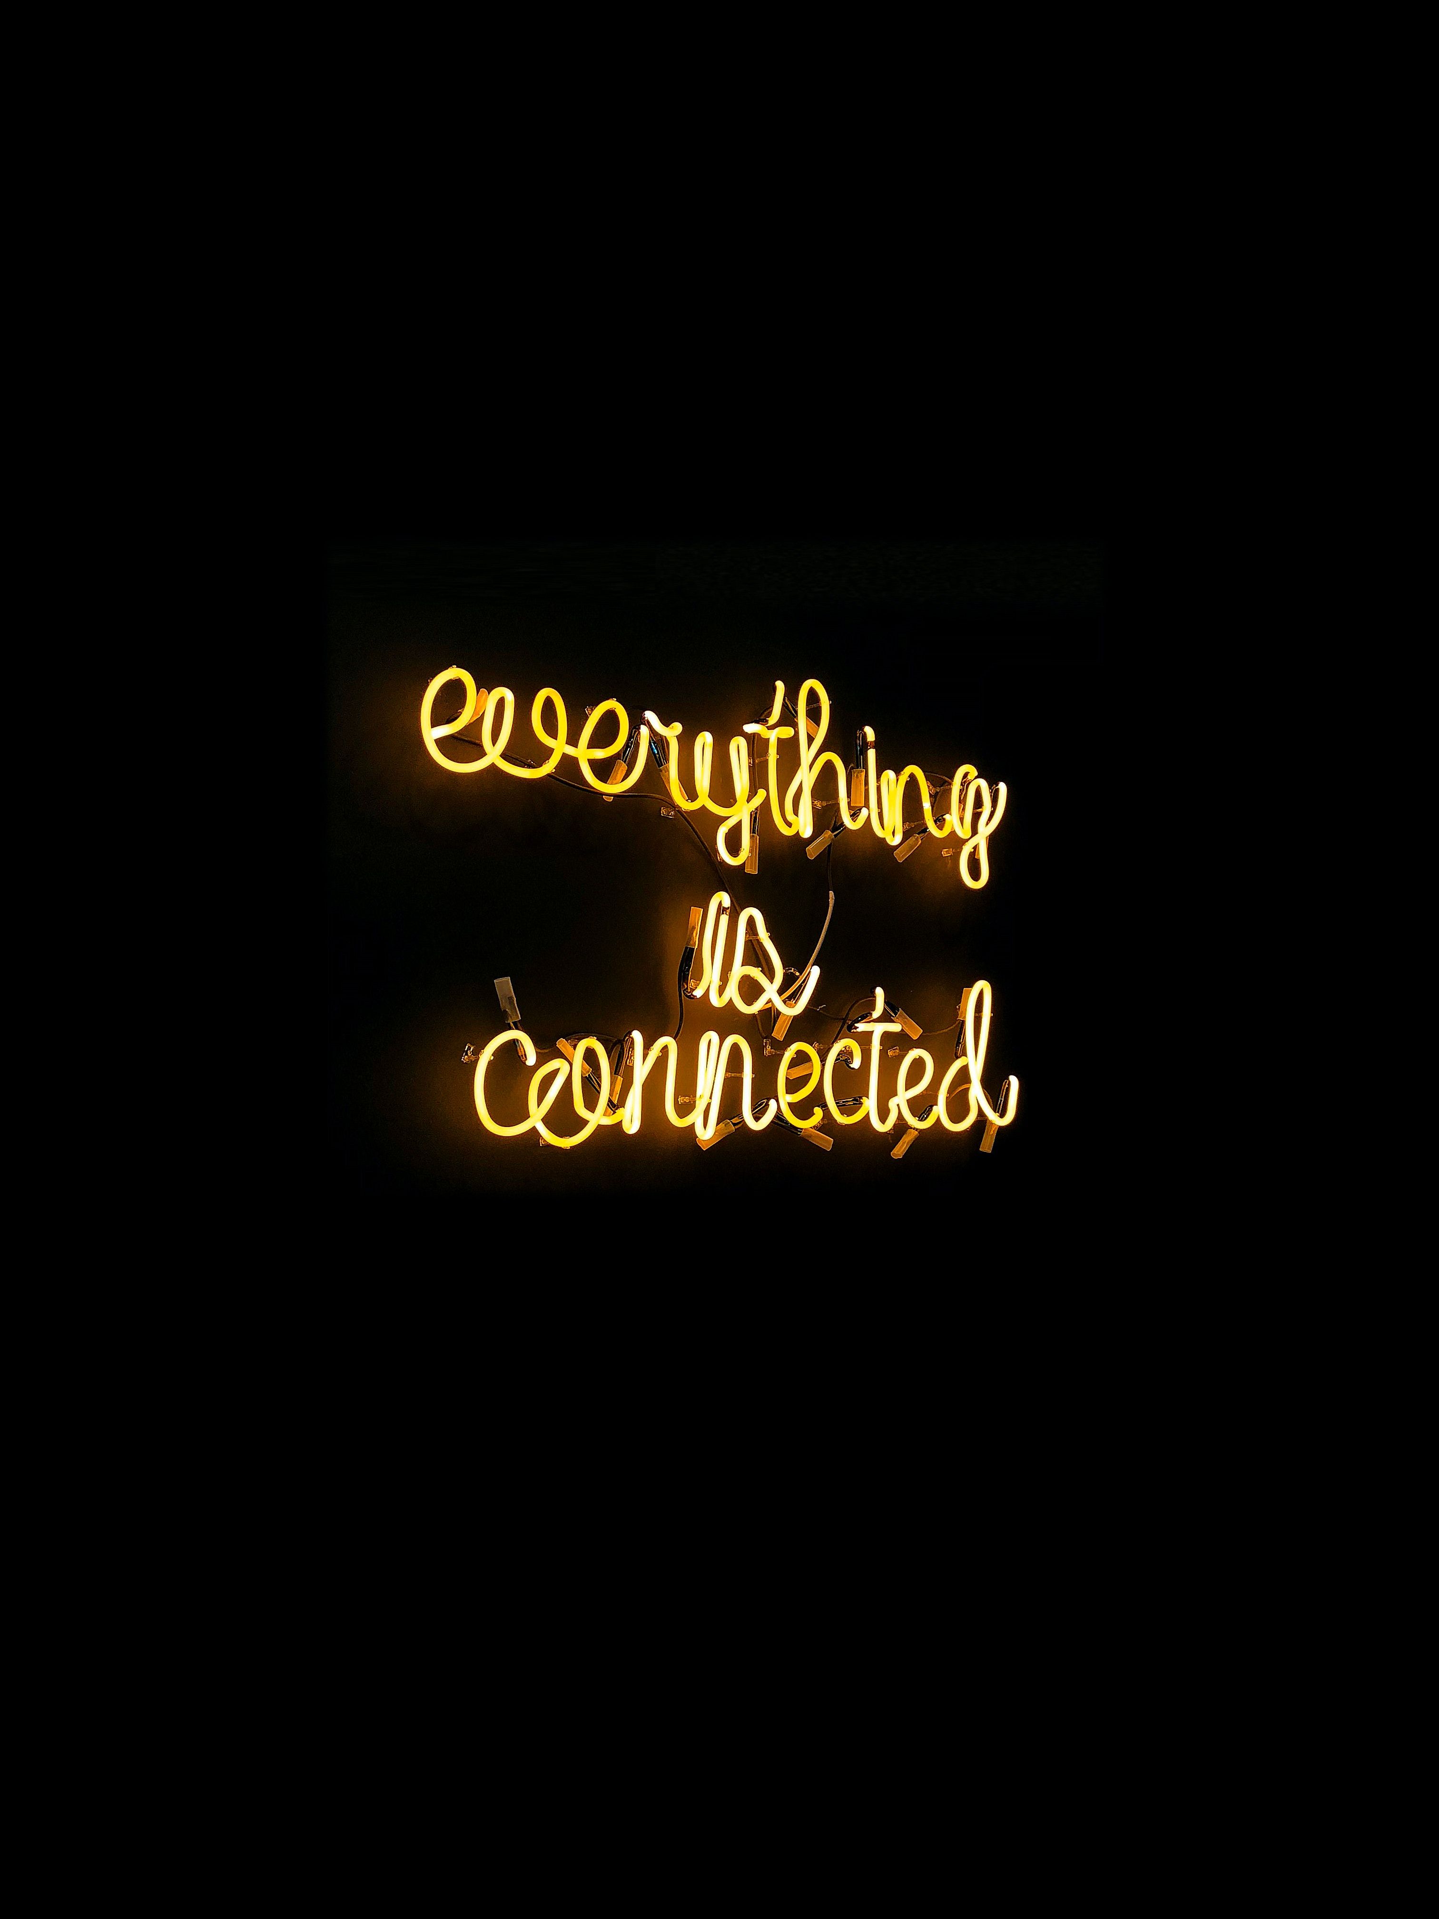
Welcome to the Geelong Small Business Festival

Slide 5
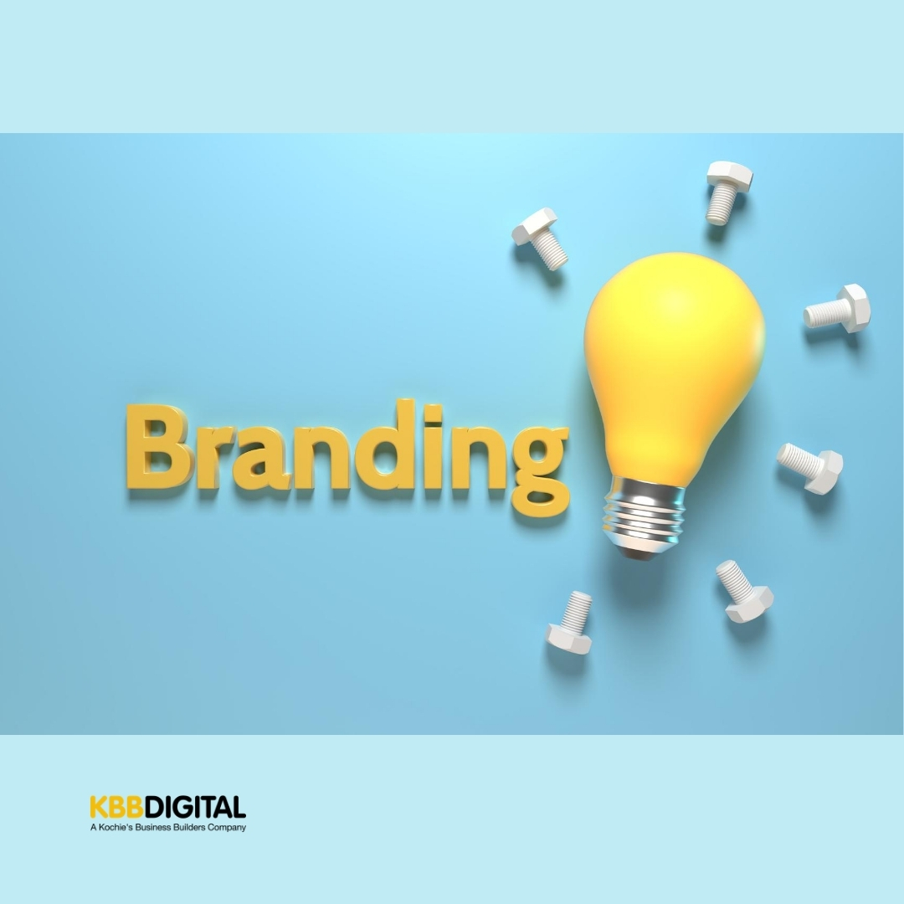

Slide 6
Branding Definition
Noun
the promotion of a particular product or company by means of advertising and distinctive design.
Or
A brand is a name, term, design, symbol or any other feature that identifies one seller's good or service as distinct from those of other sellers. Wikipedia

Slide 7
Branding
It’s also more than that, right? A brand is a feature or set of features that distinguish one organization from another.
A brand usually consists of a name, tagline, logo or symbol, design, brand voice, and more. It also refers to the overall experience a customer undergoes when interacting with a business — as a shopper, customer, social media follower, or even a passerby.
Your brand is one of your businesses most important assets. It gives your business an identity, makes your business memorable, encourages consumers to buy from you, builds trust with your customer. Plus it supports your marketing and advertising.

Slide 8
Branding
Branding can be a deciding factor for your customers, when they make a purchase decision.
In 2015 a global Nielsen survey found that almost 60% of shoppers said they actively buy from brands they know, and 21% said they bought a product because they like the brand.
Branding gives your business an identity more than just its product or service. It gives customers something to relate to and connect with.
Branding makes your business memorable. It’s the face of your business and helps consumers recognise your business across every platform.

Slide 9
Branding
Branding supports your marketing and advertising efforts and helps your promotions get extra reach with added recognition and buy in.
If you have staff in your business, branding done well can bring your employees’ pride. When your company has a strong brand identity your employees will feel part of a highly regarded workplace.
Think Apple, Google, Facebook their strong brand brings in strong employees.

Slide 10
Branding Terms
Brand Awareness
Put simply, how familiar is the general public and your target audience with your brand. Brand awareness is important, your potential customers can’t consider your brand if they’re not aware of it.
Brand Extension
This is when companies extend their brand, think clothing labels introducing homewares, or candles. Brand extensions creates more revenue streams.
Brand Identity
This is the personality of your business and the promise you make to your customers. It’s usually made up of your company values and how you want your customers to feel when they interact with your business.

Slide 11
Branding Terms
Brand Management
This term refers to the nuts and bolts process of creating and maintaining your brand. Including things like style guides, packaging, colour palette and the things you can’t touch, like how your brand is perceived by your target audience. It’s a fluid thing and requires consistent upkeep!
Brand Recognition
How well can your customers recognize and identify your brand without seeing your business name – through your logo, tagline, packaging, ads etc. A strong brand will keep your business top-of-mind.
Brand Trust
How strongly do your customers believe in your brand? Do you deliver on your promises? Does your product or service deliver? Do you and your team go above and beyond. A strong brand builds trust.

Slide 12
How do we create a brand?
This is where your work begins. And like most things, it’s easier said than done. It’s where lots of businesses struggle and fall-down.
STEP 1 - Determine your target audience.
If your brand doesn’t connect with your audience, it won’t drive the awareness, trust and ultimately the revenue you need.
So, do some research, talk to as many people as you can and answer these questions:
Who does your product serve?
What problem is your product or service solving?
Who is your ideal customer?
Why did you create your business in the first place?

Slide 13
How do we create a brand?
STEP 2 – Write Your Mission Statement
Your mission statement goes back to my last question. Why did you start your business? Answering this will help you define your purpose and passion as a business. You must be able to communicate the purpose of your business and what you provide to your customers. Once you’ve stated this, every part of your brand will reflect this mission and vision.
Patagonia:
“Build the best product, cause no unnecessary harm, use business to inspire and implement solutions to the environmental crisis”.
Tesla:
“To accelerate the world's transition to sustainable energy”.

Slide 14
How do we create a brand?
STEP 3 – Define your uniqueness. Qualities, Benefits, Difference
So let’s be honest, unless you’ve found the magical unicorn, you won’t be the ONLY business in your market doing what you do. However the one thing you have that your competitors don’t, is ………..your BRAND. Your brand values, benefits and qualities make your business unique.
So take some time and write down what sets your business apart from your competitors.
Not an easy one. Here’s how we answered this question.
“As a digital agency we love to talk, either face to face or on the phone.”
For us we know our competitors often don’t want to “talk”, they’re happy to email or use “chat” bots – but not actually talk.

Slide 15
How do we create a brand?
STEP 4 – The fun stuff – Create your actual brand assets
We’re talking about logo’s, taglines, colour palettes, font types, language and any other visual aids / imagery.
While you’re doing this, it’s time to start building your Style Guide. This is a set of ‘rules’ around the use of your visual assets and their composition. For example not changing the ‘aspect ratio’ or simply put the proportions of your logo. Not using certain words in copy.
This can be super fun or super scary, so if you’re stuck reach out to a professional. A little cost upfront will ease a whole lotta pain later!

Slide 16
How do we create a brand?
STEP 5 – Finding your brands VOICE and I’m not asking you to sing!
Some of you will be nodding along and some will be scratching their heads thinking, what the?
So, think of it this way – If your brand could have a conversation with you or even send you a text, what would it sound like? How you communicate is part of your brand, how you sound and the language you use.
Your brand voice needs to connect with your target audience and be recognizable.
So, if your target market is a 35 – 55 year old male who’s into chopper bikes and muscle cars you’re going to use very different language and tone (your voice) than if your target market is a 15 – 19yr old girl, who’s into makeup, right? And hey, your voice can have light and shade. It can be professional with a touch of fun or youthful and light but also intelligent…..
Find your “voice” and use it in all that you do!

Slide 17
How do we create a brand?
STEP 6 – Now it’s time to put your brand into all that you do.
”If Content is King then, Consistency is Queen”
This means applying your brand components across every touch point within your business, no matter how large or small.
Website
Get your logo, colours, fonts and language right across your entire site. Only use assets that you have determined form part of your brand. Your website is your businesses online shop front and must represent your brand, it’s language and values impeccably. Be sure your web copy and calls-to-action are inline with your brand voice.
This is where brand awareness starts to form.

Slide 18
How do we create a brand?
STEP 6 – Now it’s time to put your brand into all that you do.
”If Content is King, Consistency is Queen”
Socials
All profile photo’s, cover imagery, language etc aligns with your brand style guidelines. And like with your website make sure all posts align with your brand and language.
That being said, you can have aspects of your brand showing up in different channels, for example if you’re on LinkedIn your posts will be more corporate, but if you’re posting on Insta or maybe getting in on the TikTok game, you can bring some of the light hearted fun aspects of your brand, while still keeping true to your core values.

Slide 19
How do we create a brand?
STEP 6 – Now it’s time to put your brand into all that you do.
”If Content is King, Consistency is Queen”
Packaging
If you have physical product with your business, then you need to ensure that your brand style guide is reflected in your packaging, fonts, colours and imagery across all aspects of your packaging. Think boxes, paper, cards, tissue paper, ribbons and stickers.

Slide 20
How do we create a brand?
STEP 6 – Now it’s time to put your brand into all that you do.
”If Content is King, Consistency is Queen”
Ads
Ensure all digital and print advertisements reflect your branding. Colours, fonts, imagery, tone and voice, logo’s are all consistent and in line with brand.
Sales & Customer Service
Your brand is powerful when all of the people who are part of your business embody and incorporate the brand in all that they do. It’s how you speak to customers, pack orders, deal with complaints and correspond with customers. Your brand should permeate through every fibre of your business.

Slide 21
So, let’s review……
Treat your brand as a person
Consistency is Queen
Follow your brand strategy
Let your uniqueness, your point of difference shine through and remember to be honest……..
Your brand is that intangible feeling your customers have when they interact with your business.

Slide 22
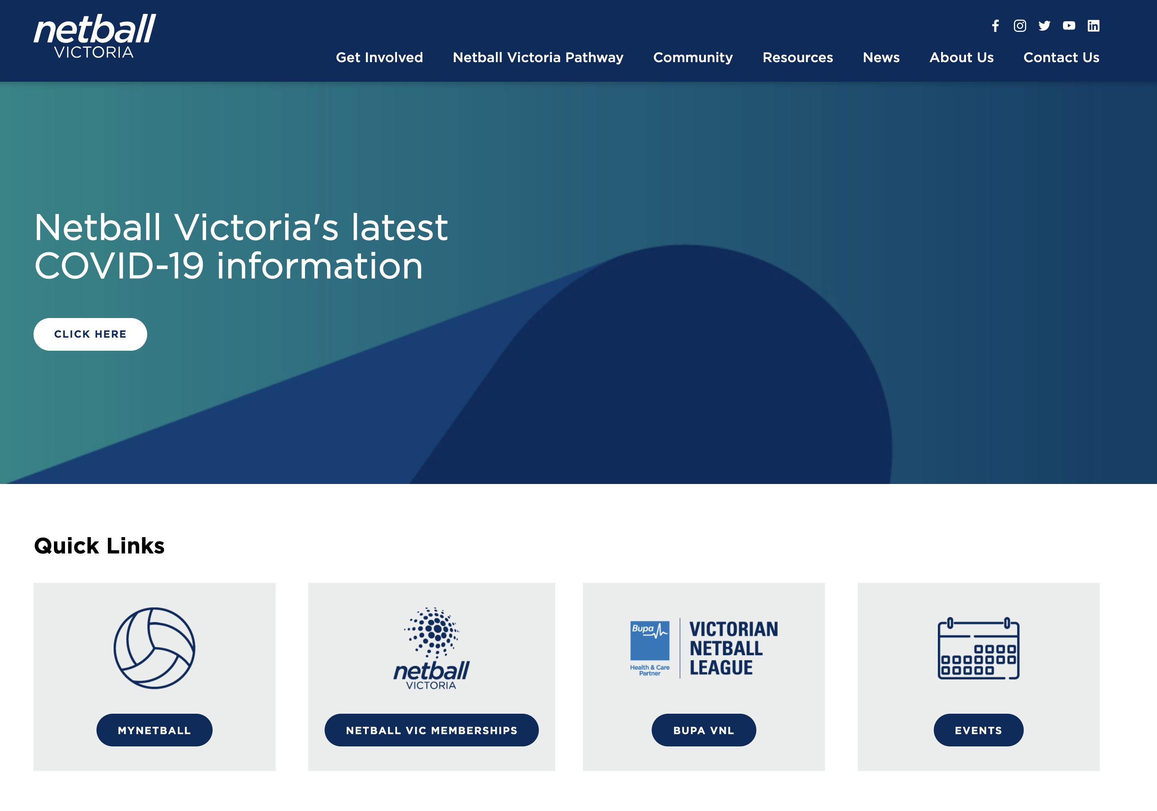
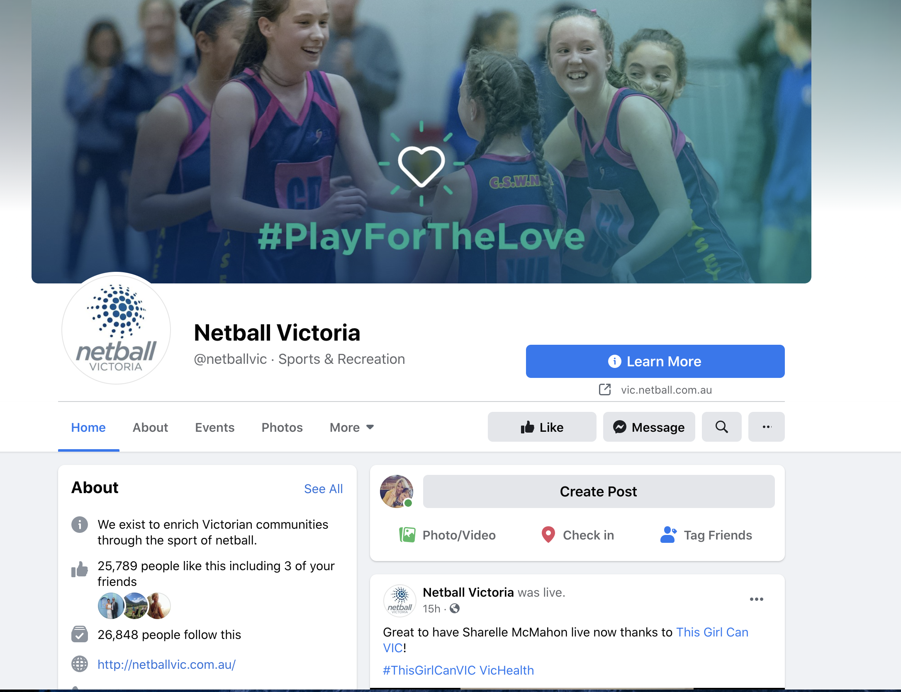
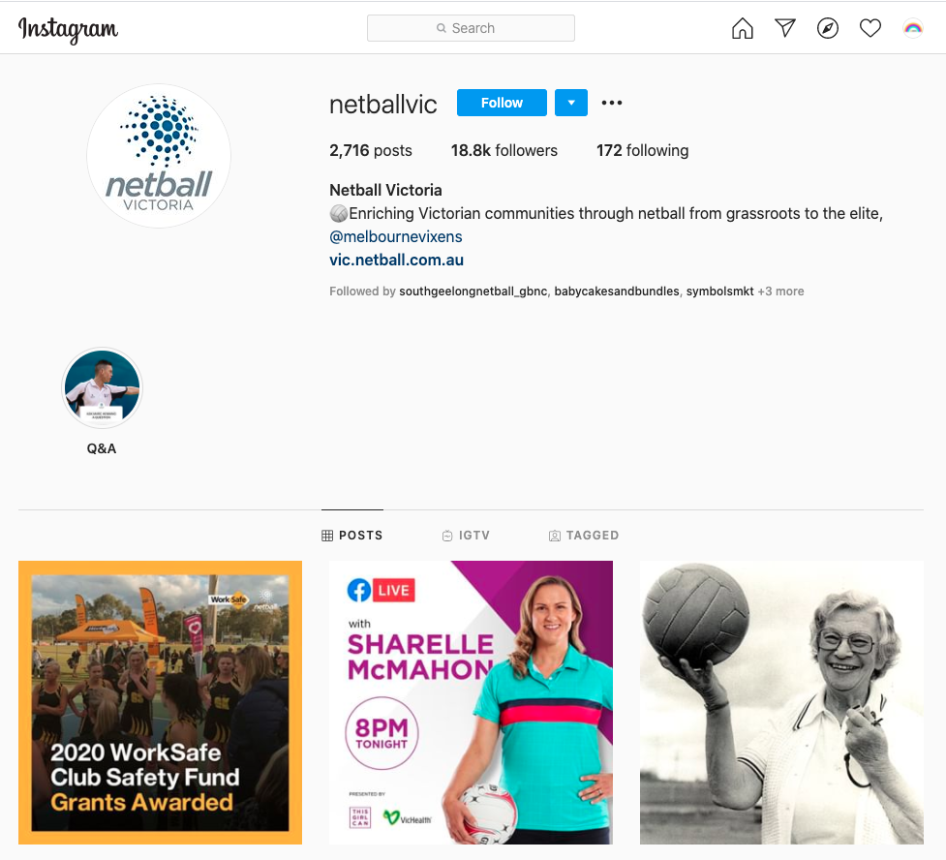
Brands that get it oh so right!
All tell a story of who they are and what they do. You can see the consistency across their different platforms……
Netball Victoria

Slide 23
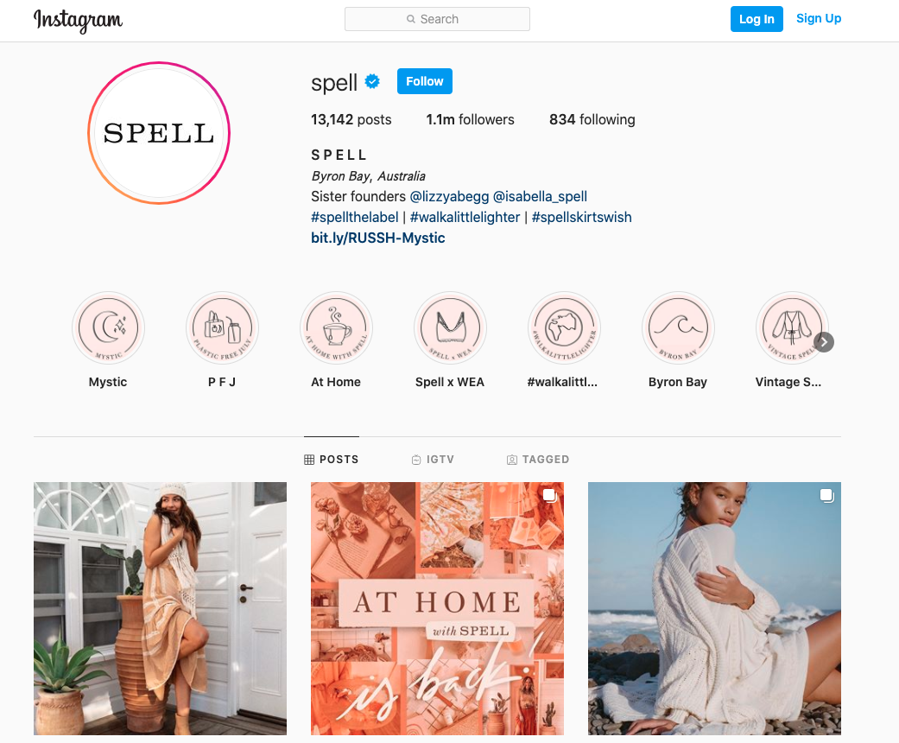
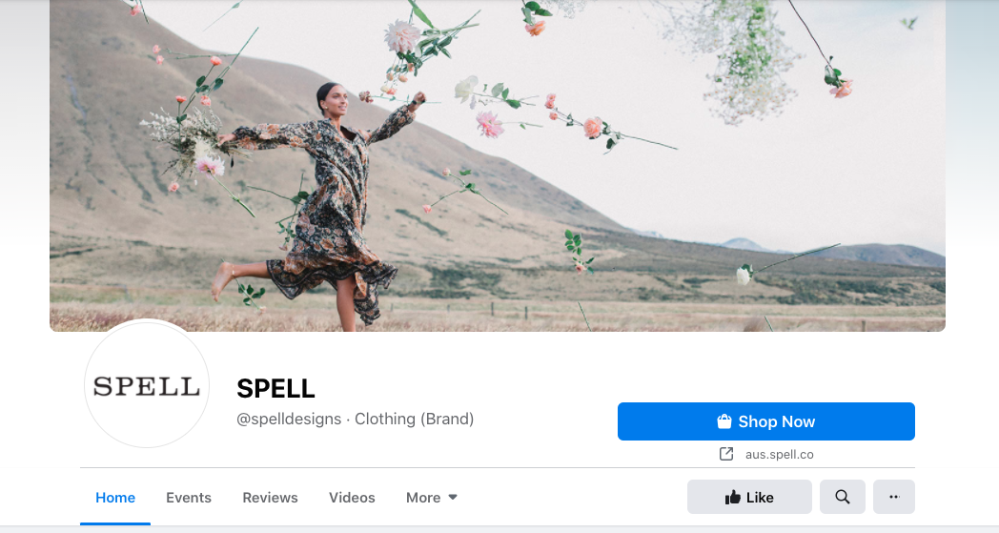
Brands that get it oh so right!
Spell, Byron Bay

Slide 24
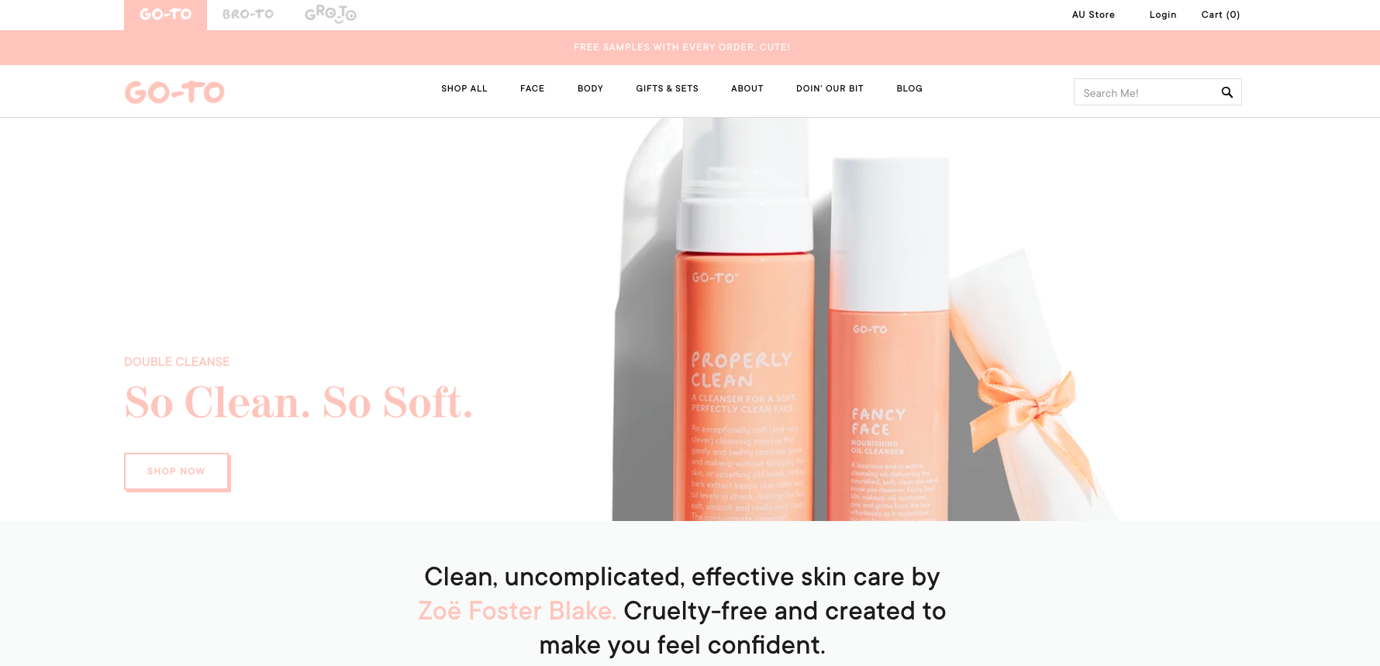
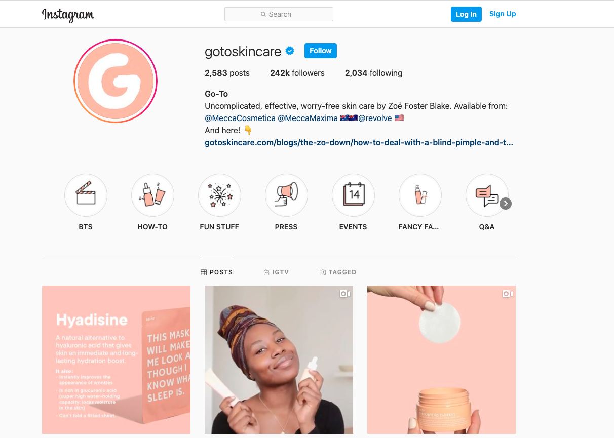
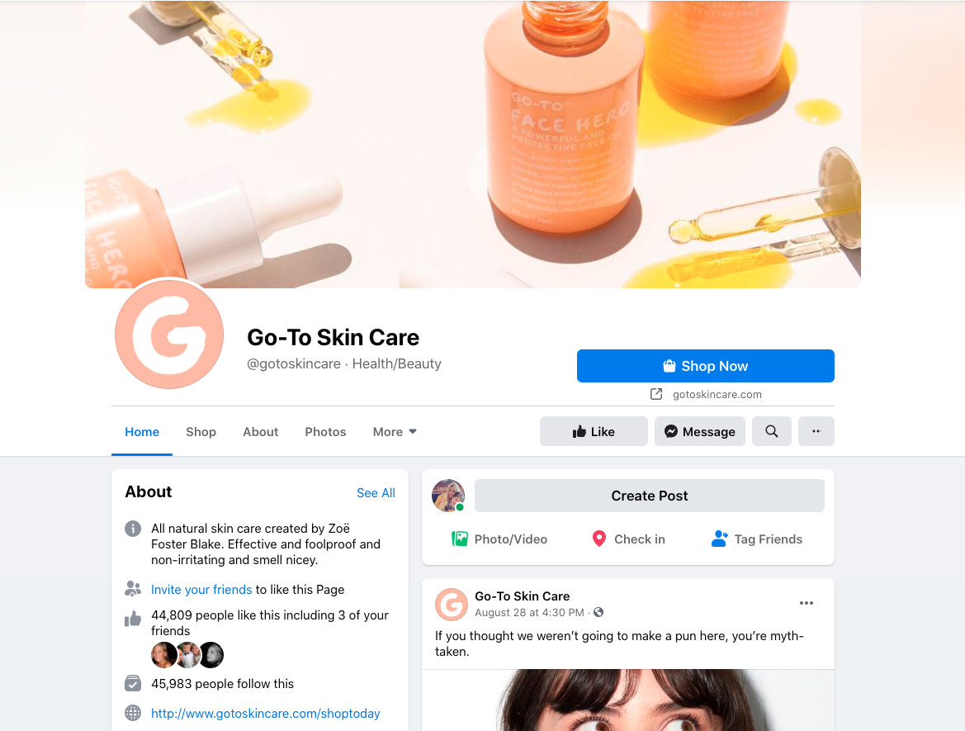
Brands that get it oh so right!
Go-To SkinCare

Slide 25
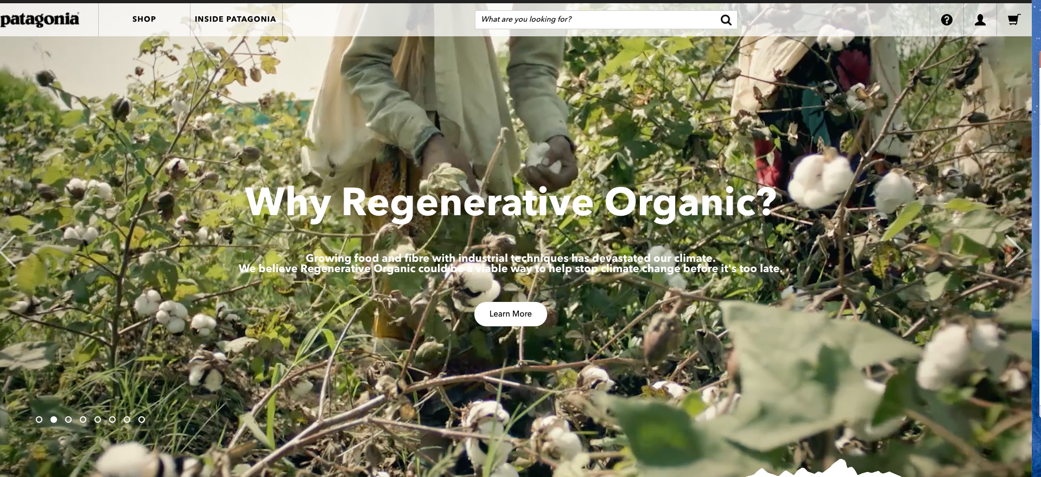
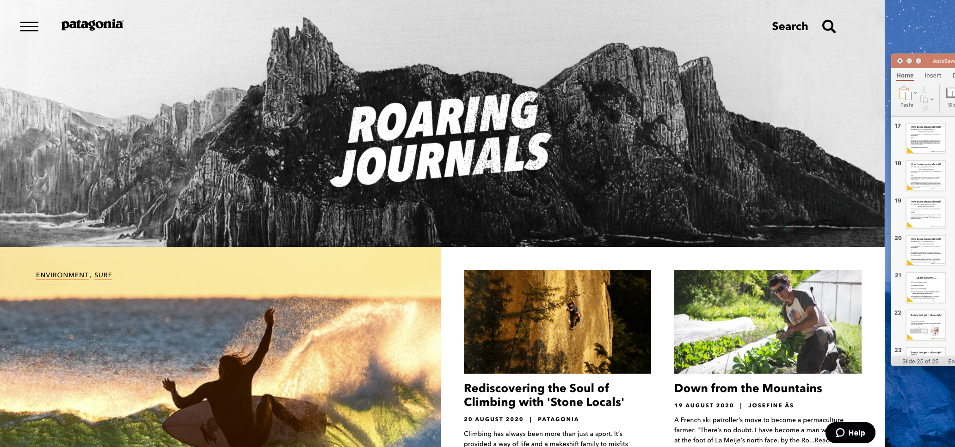
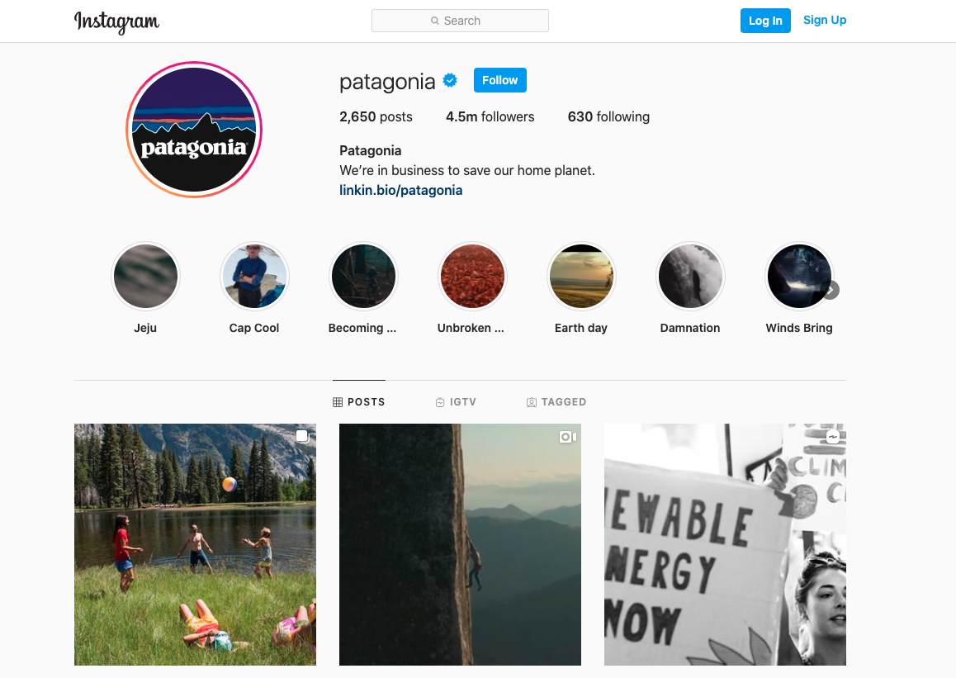
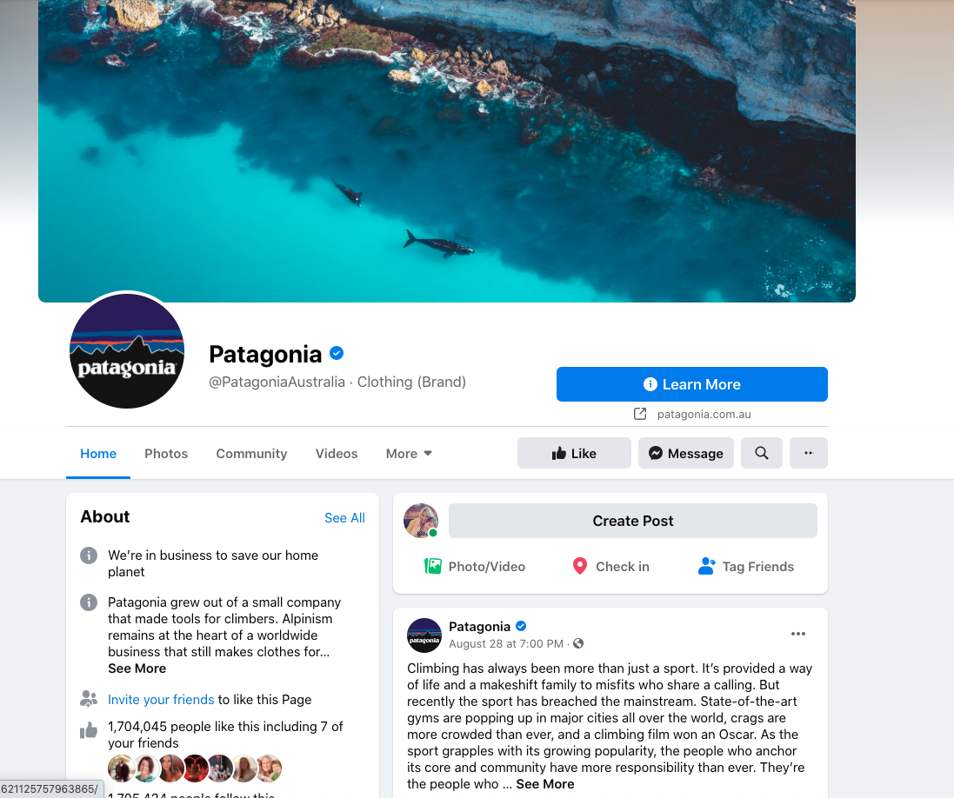
Brands that get it oh so right!
Patagonia

Slide 26
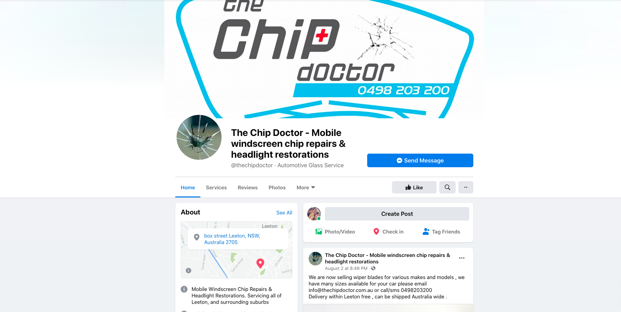
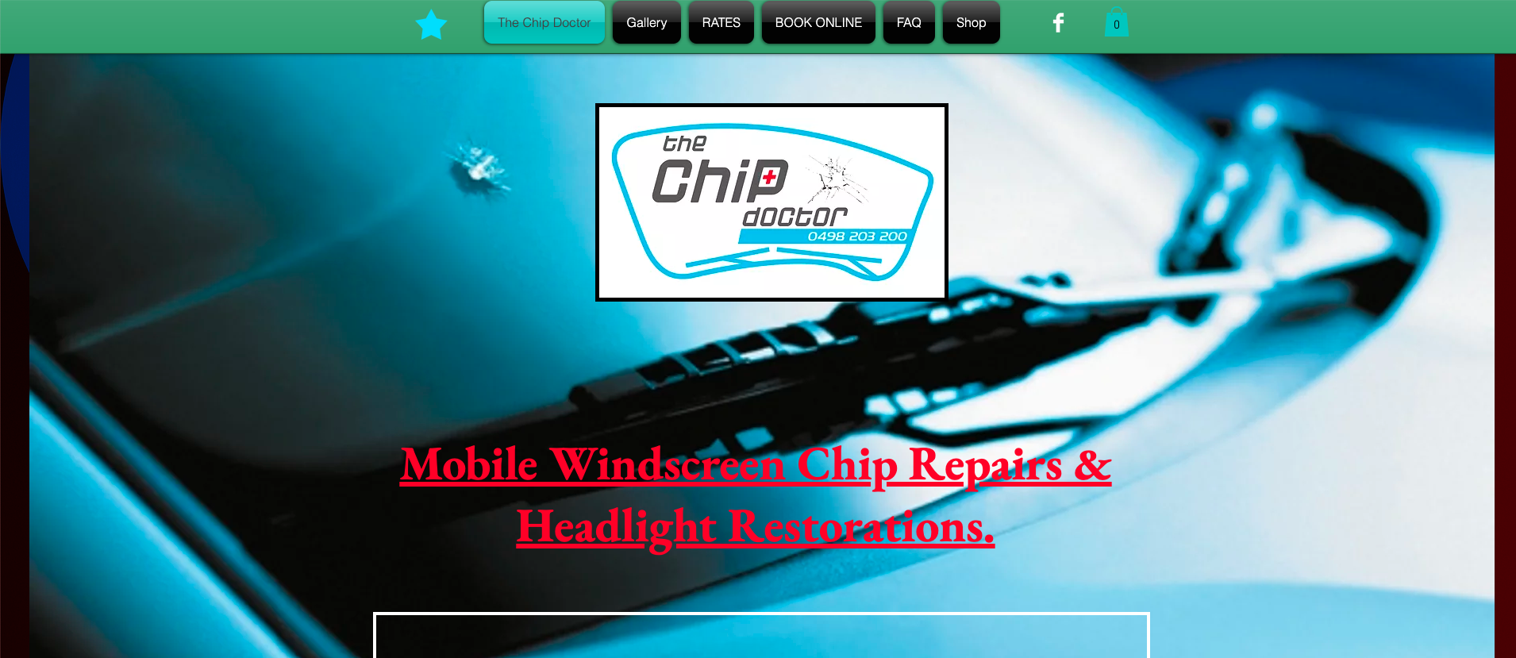
Missing the mark.
The Chip Doctor
FB is clean logo is great – messaging concise.
Logo is consistent, fonts all vary, colours are inconsistent. Creates confusion and reduces trust.

Slide 27
Question time!

Slide 28
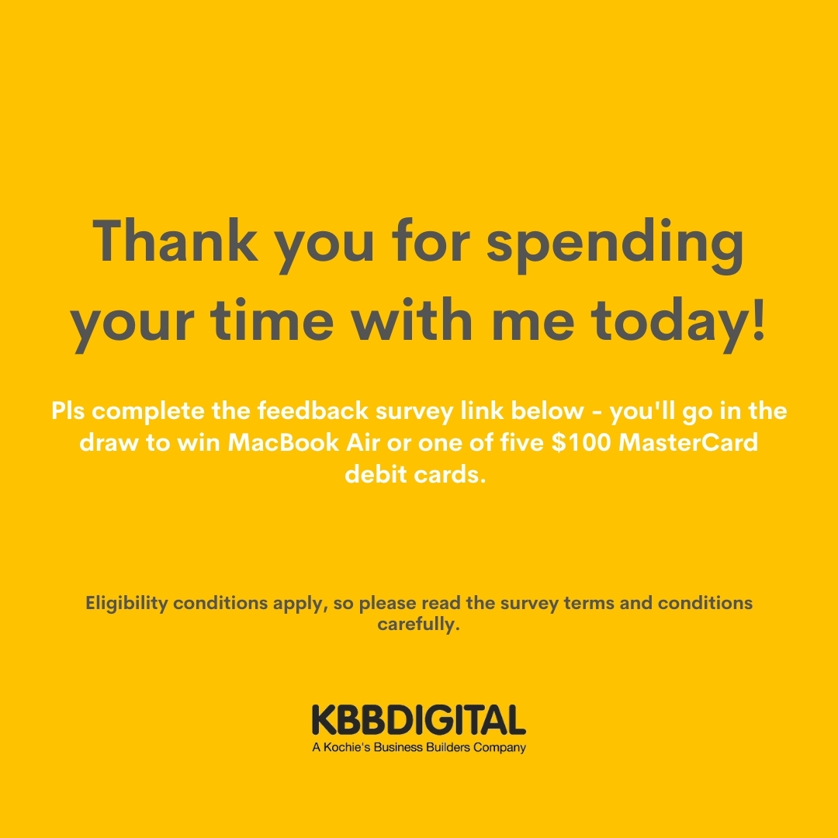
https://www.surveygizmo.com/s3/5767030/Geelong-Small-Business-Festival-2020-attendee-feedback-form-copy

